Slide 1
Urban Rabies ABM- Draft Figures

Slide 2
Questions
Can rabies be eliminated from urban landscapes at seroprevalence rates less than 60%?
Which management/ecological factors influence probability of rabies elimination and re-invasion?

Slide 3
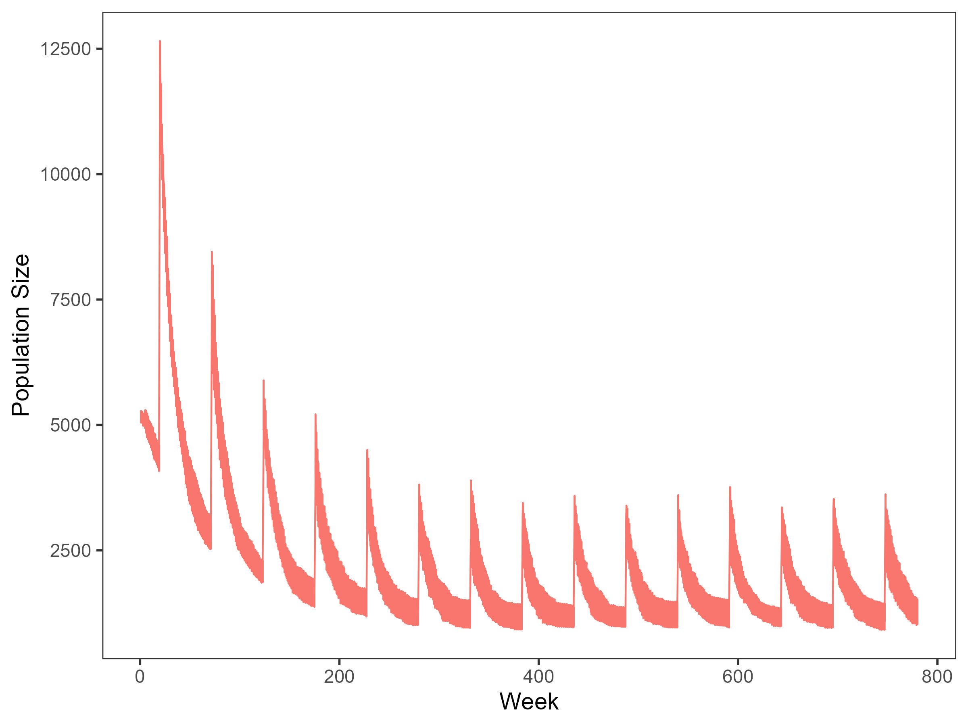
I found the problem!

Slide 4
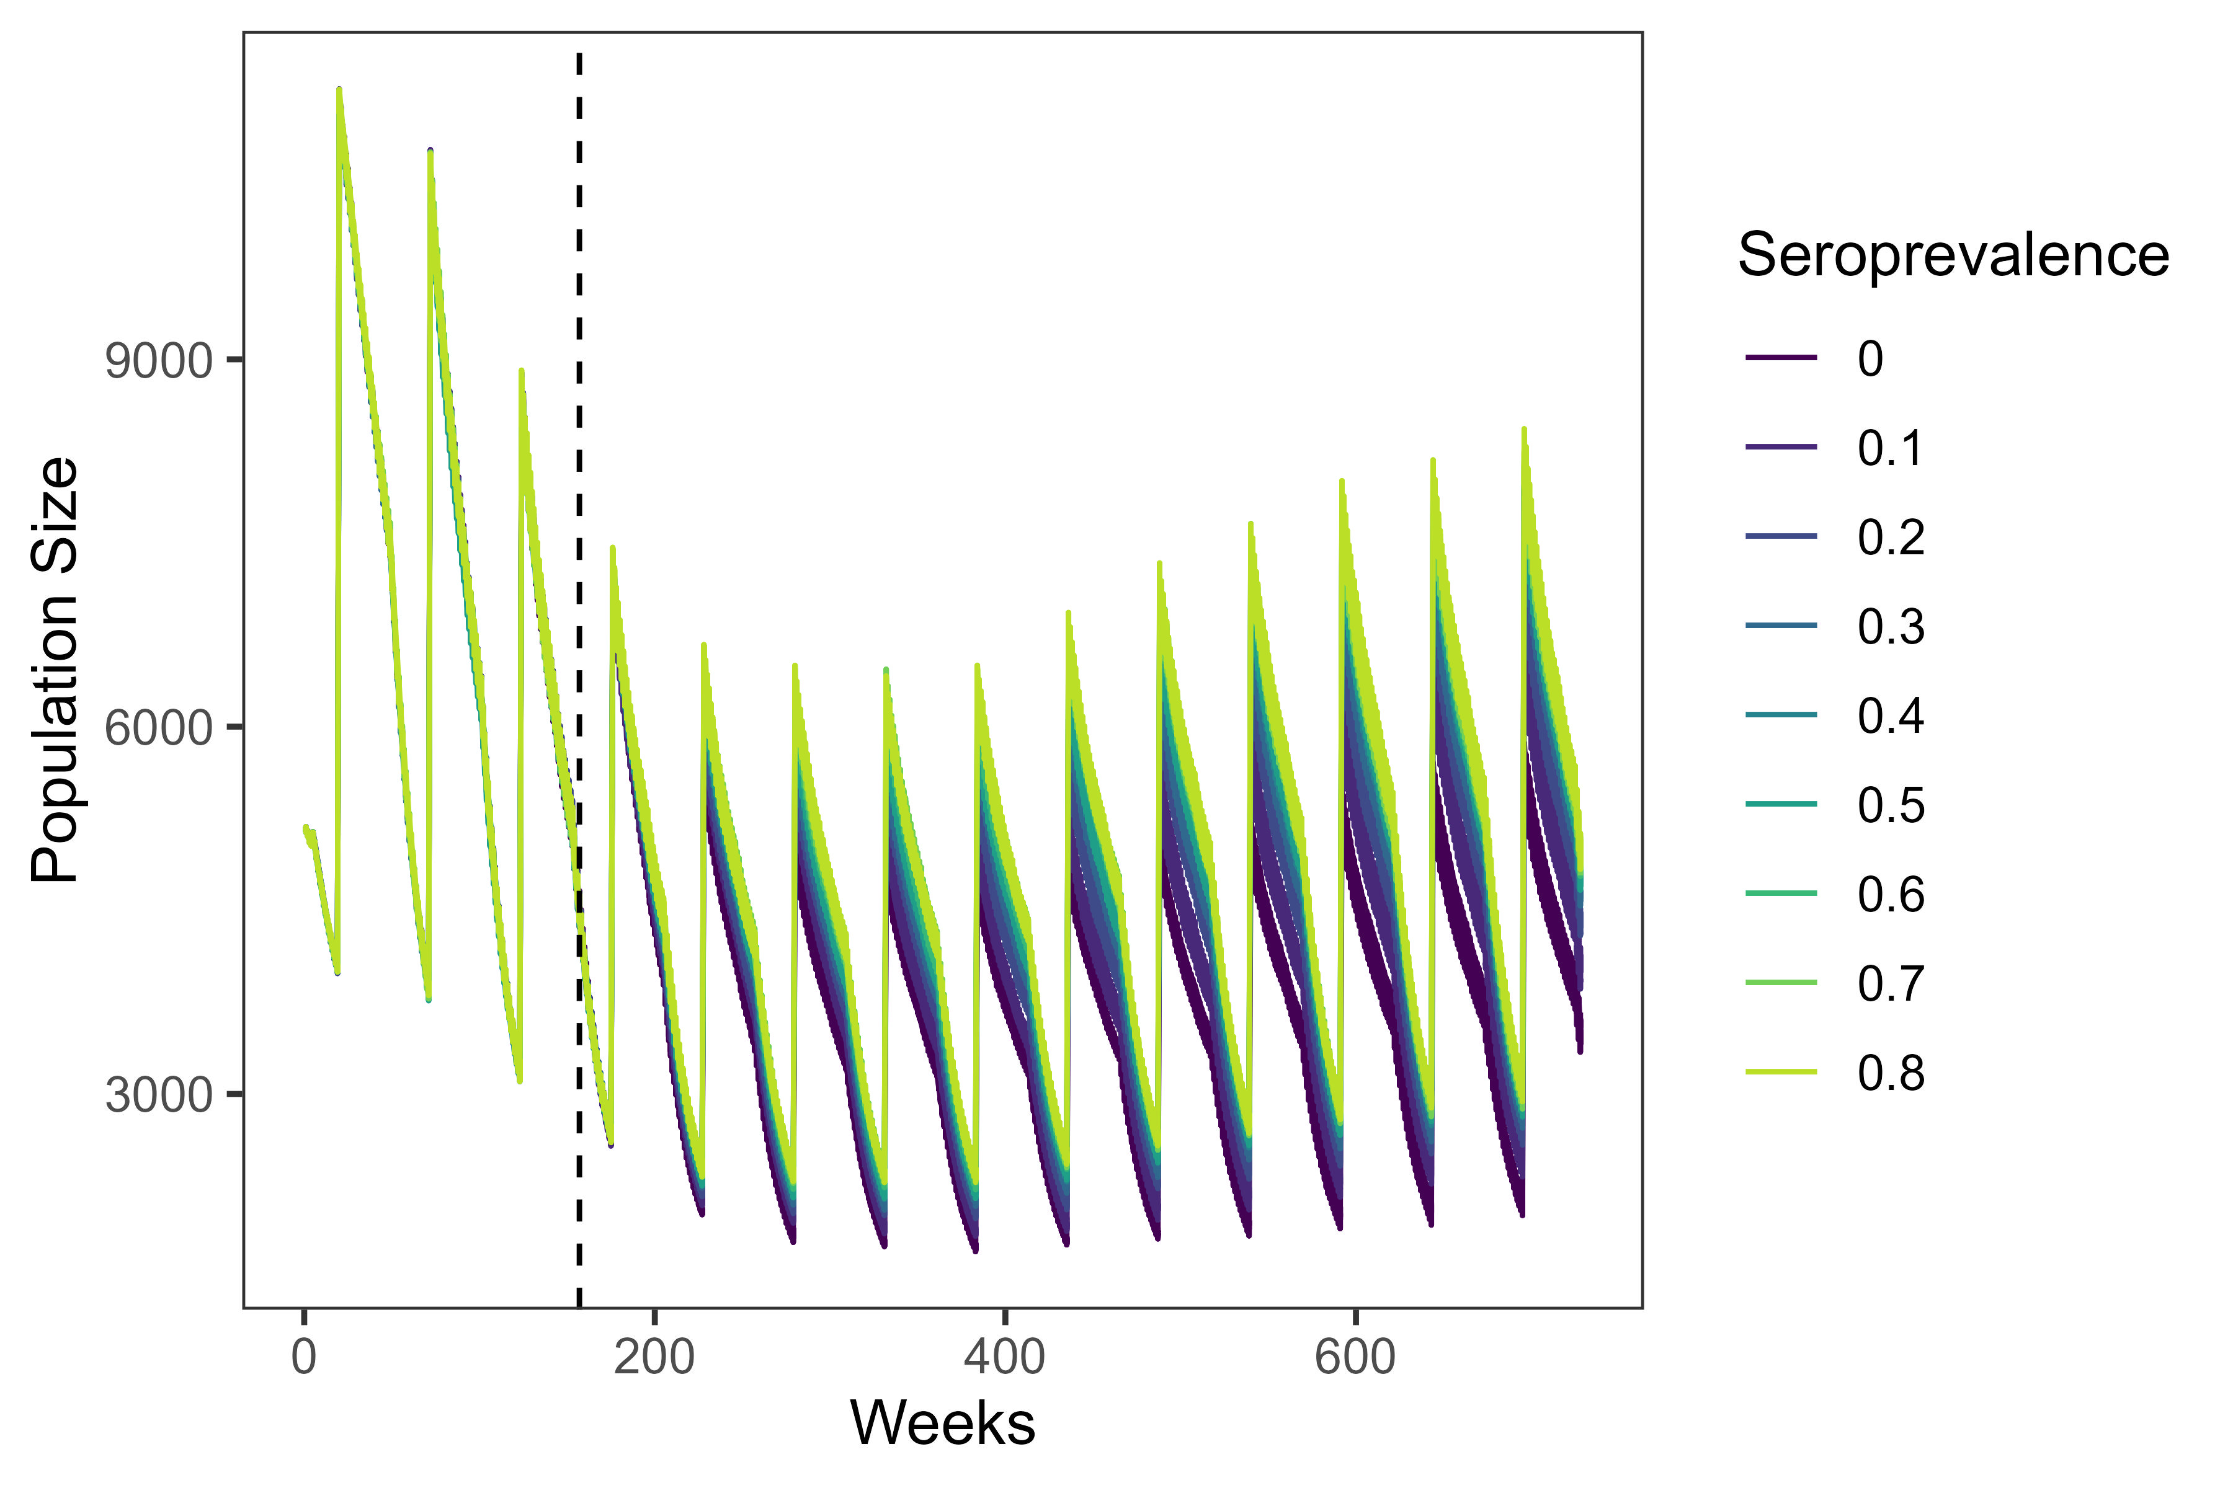
…And (mostly) fixed it

Slide 5
Prelim results

Slide 6
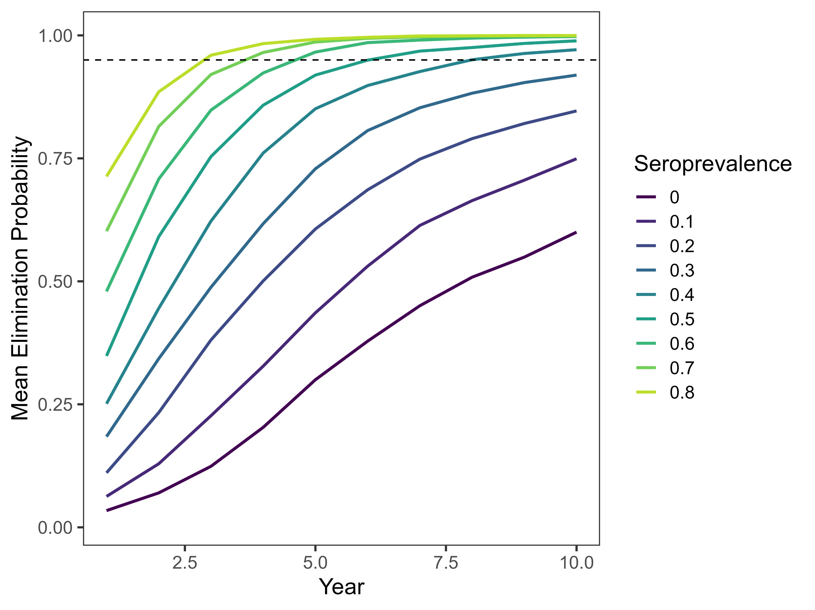
When seroprevalence is at 40% or above, rabies is eliminated at least 95% of the time within the simulation period
In this seroprevalence range, elimination typically occurs in 3-7 years

Slide 7
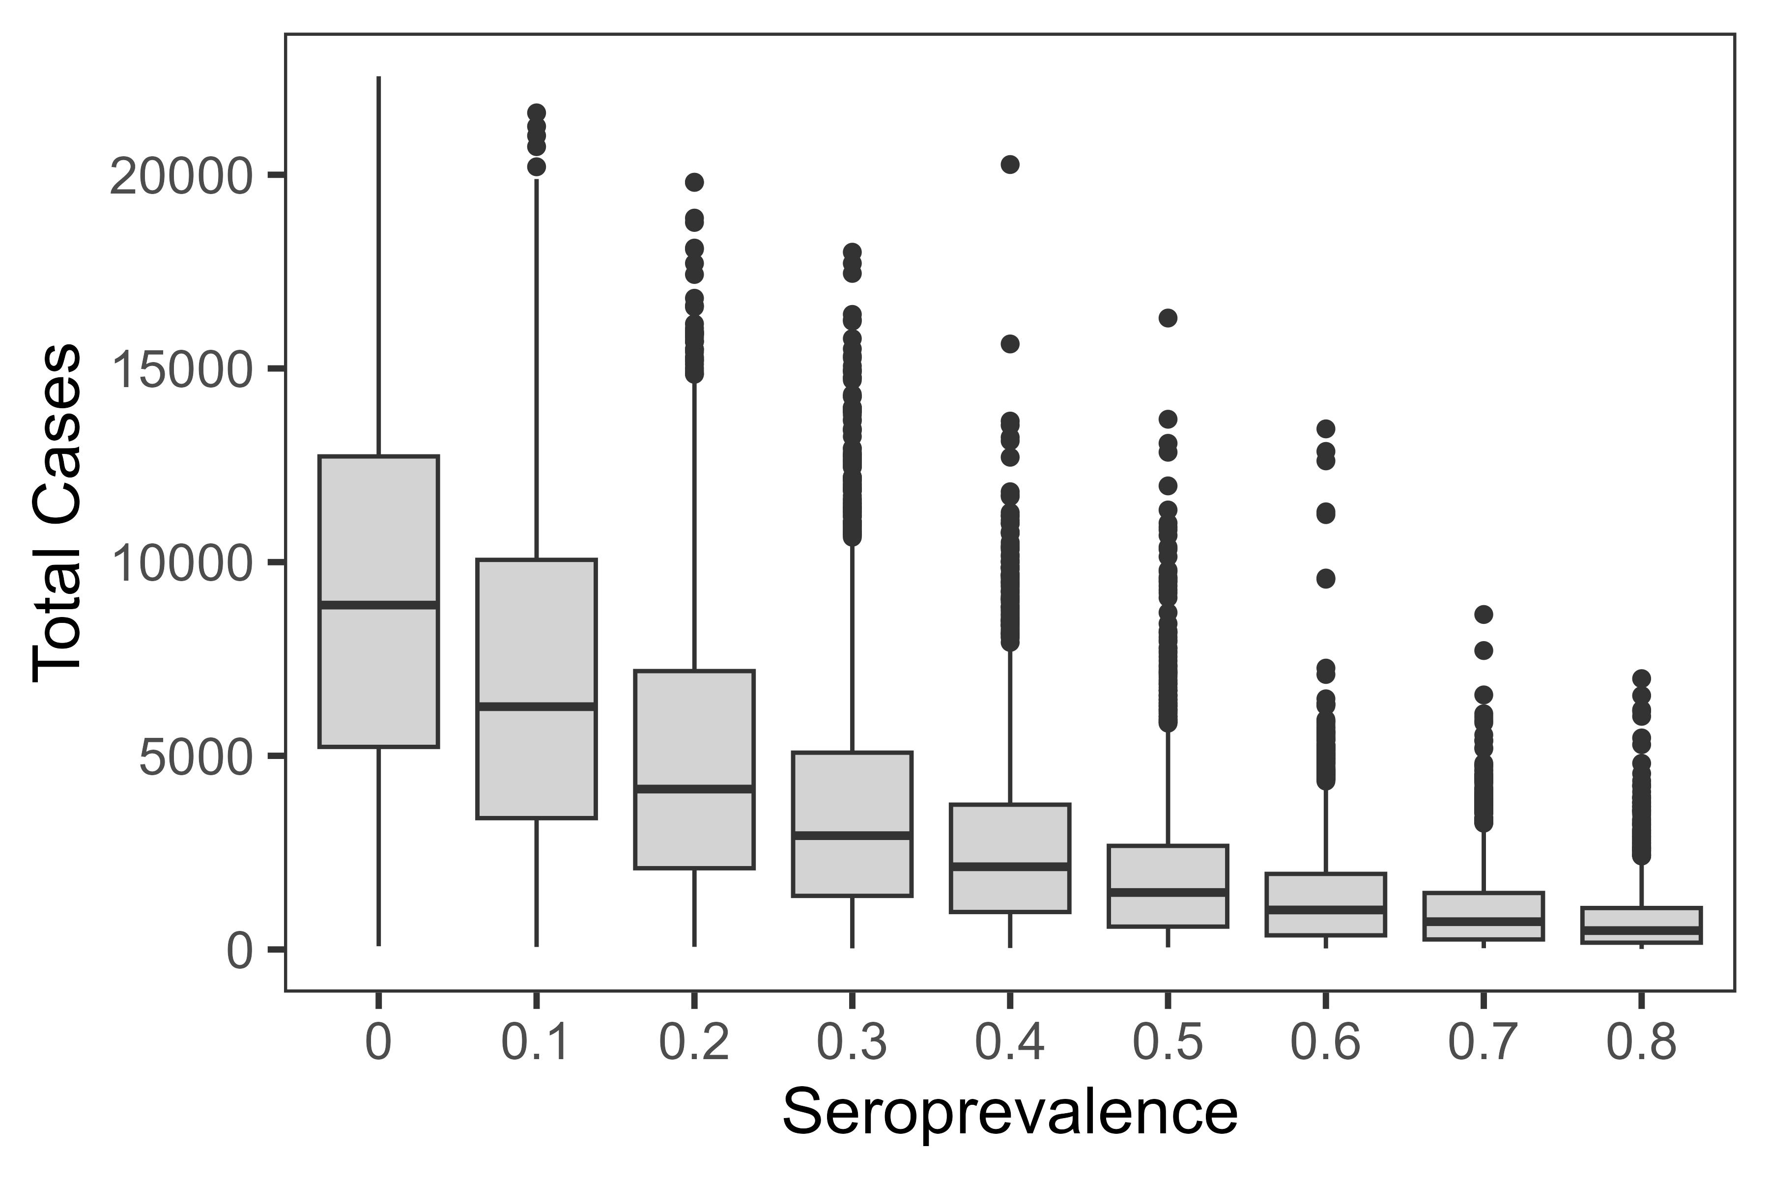
Higher seroprevalence values = fewer cases

Slide 8
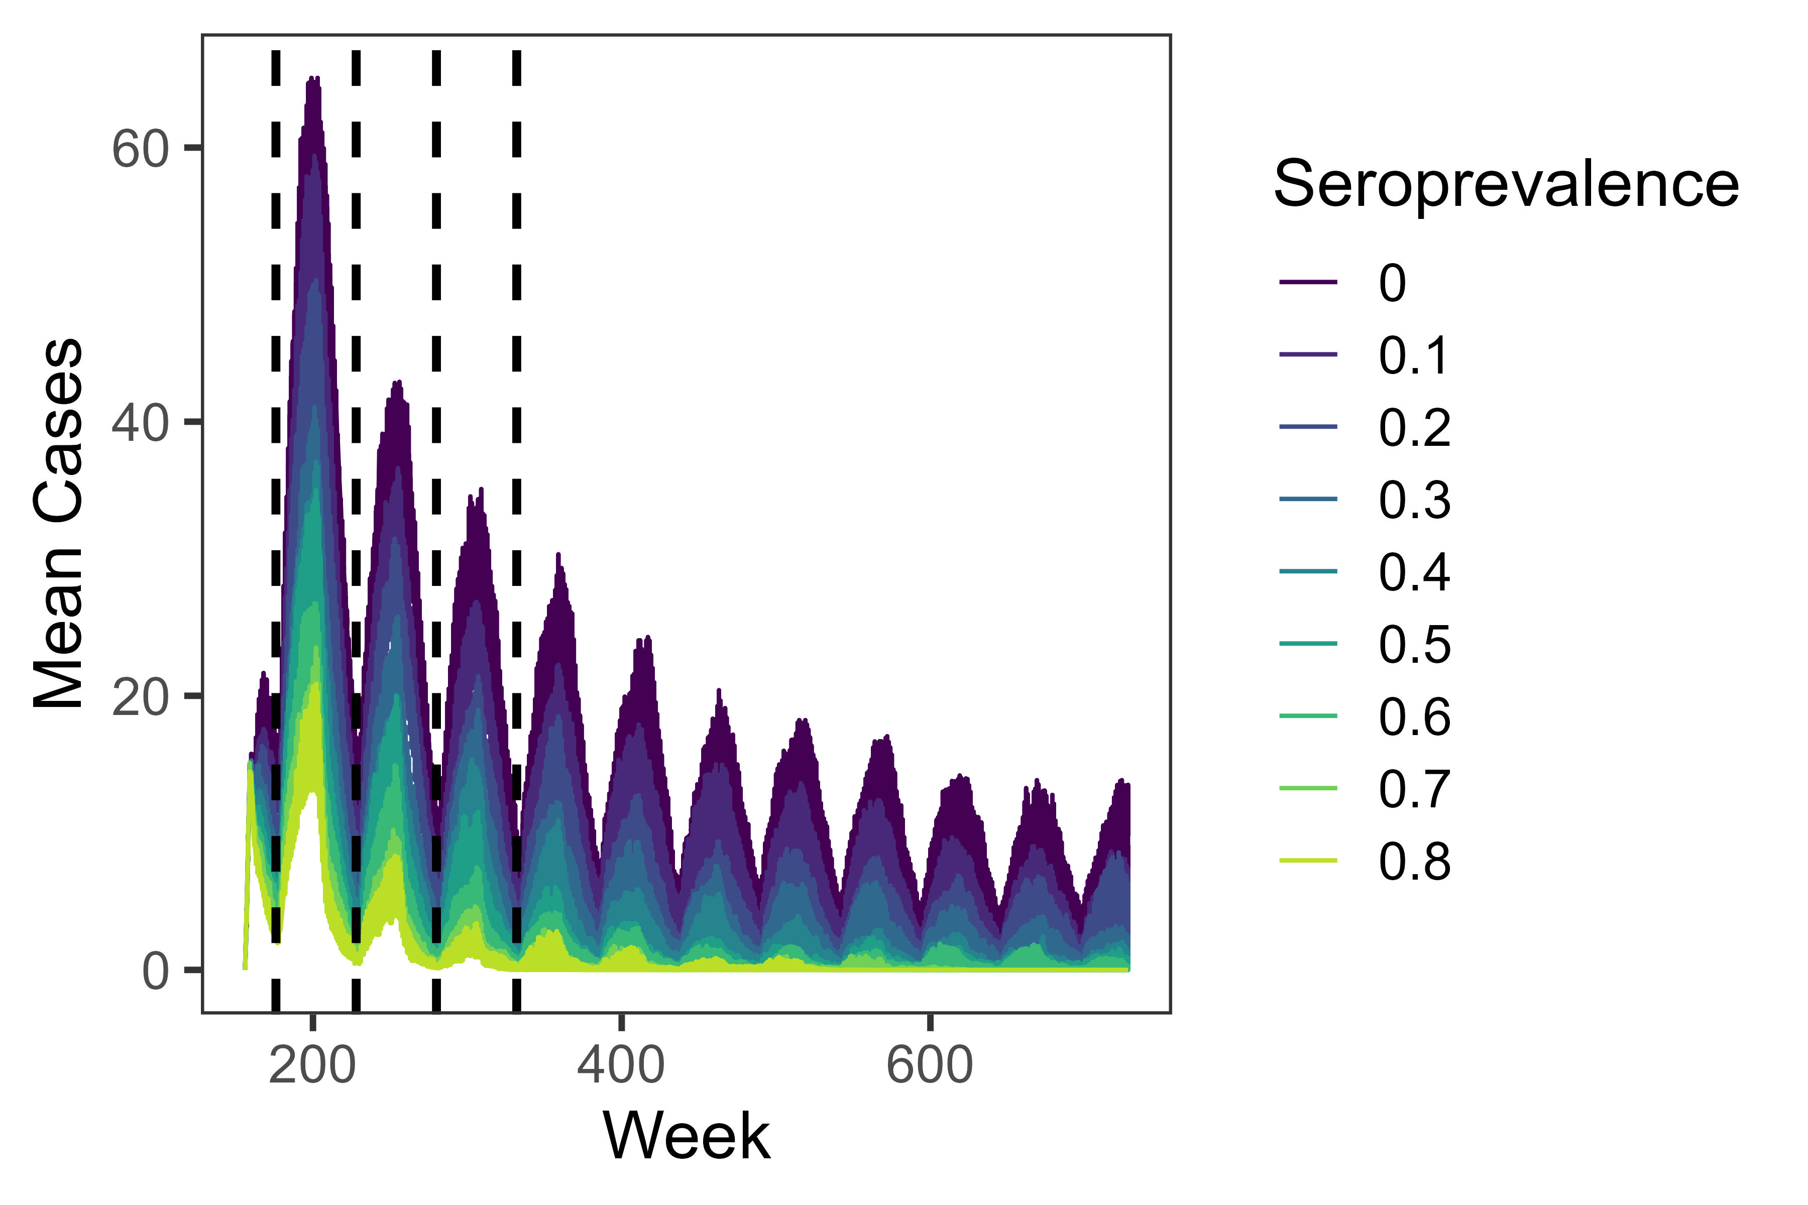
… And fewer weekly cases

Slide 9
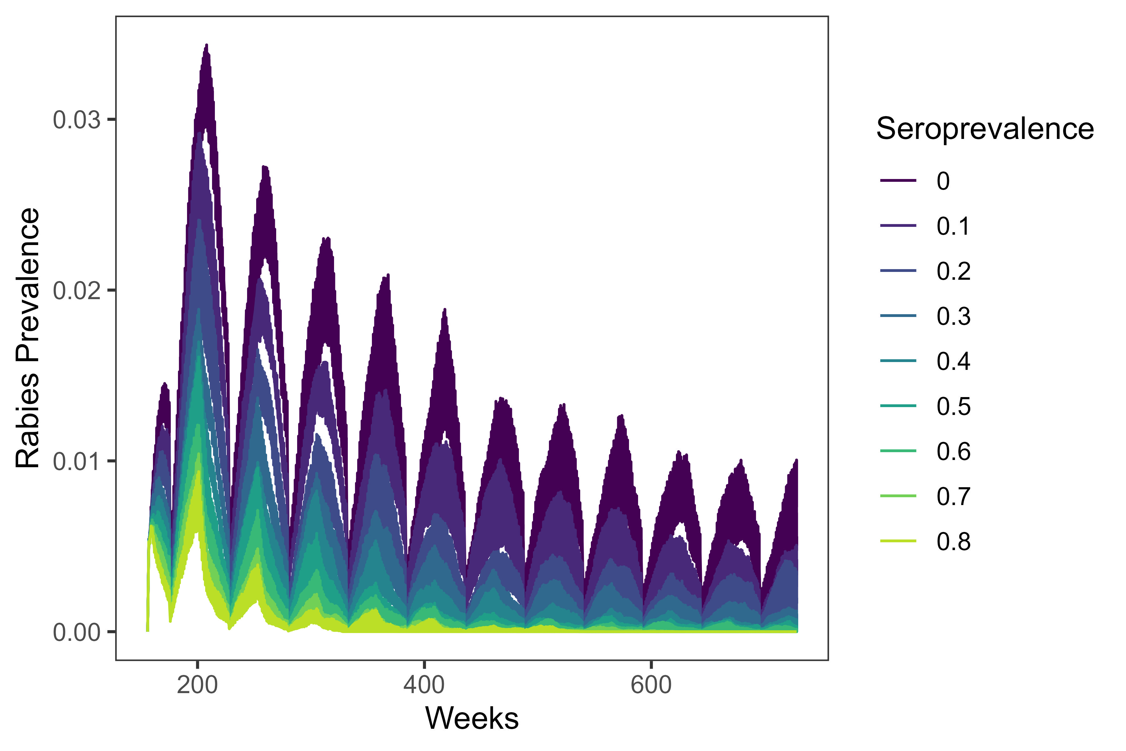
… And lower prevalence

Slide 10
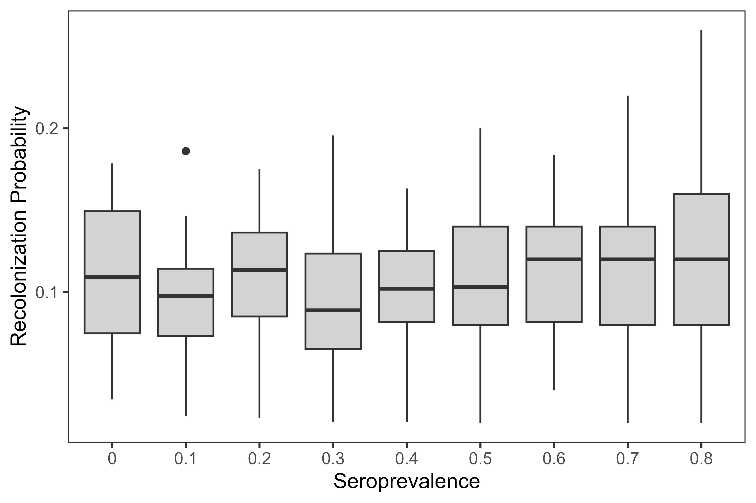
Recolonization probability was approximately equal across seroprevalence values

Slide 11
This is possibly a simulation artifact: high seroprevalence landscapes reached elimination faster, leaving more time for reinfections

Slide 12
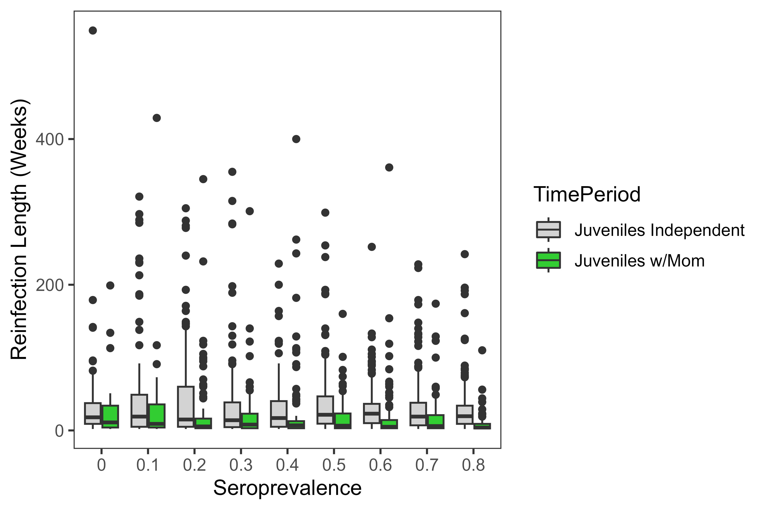
Reinfections may last slightly longer if they occur after juvenile dispersal

Slide 13
